Slide 2
Absence of Copyright
This slideshow contains photos, diagrams, and information, some of which were attained through internet searches of public websites. The author of this presentation does not own the copyright on this information, so this slideshow is for personal use only—not for sale or profit. Please utilize it to seek the Lord and grow in your knowledge of His Word and ways.
Bro Stan’s Revelation Study is available on our church website:
www.faithprinceton.org

Slide 4
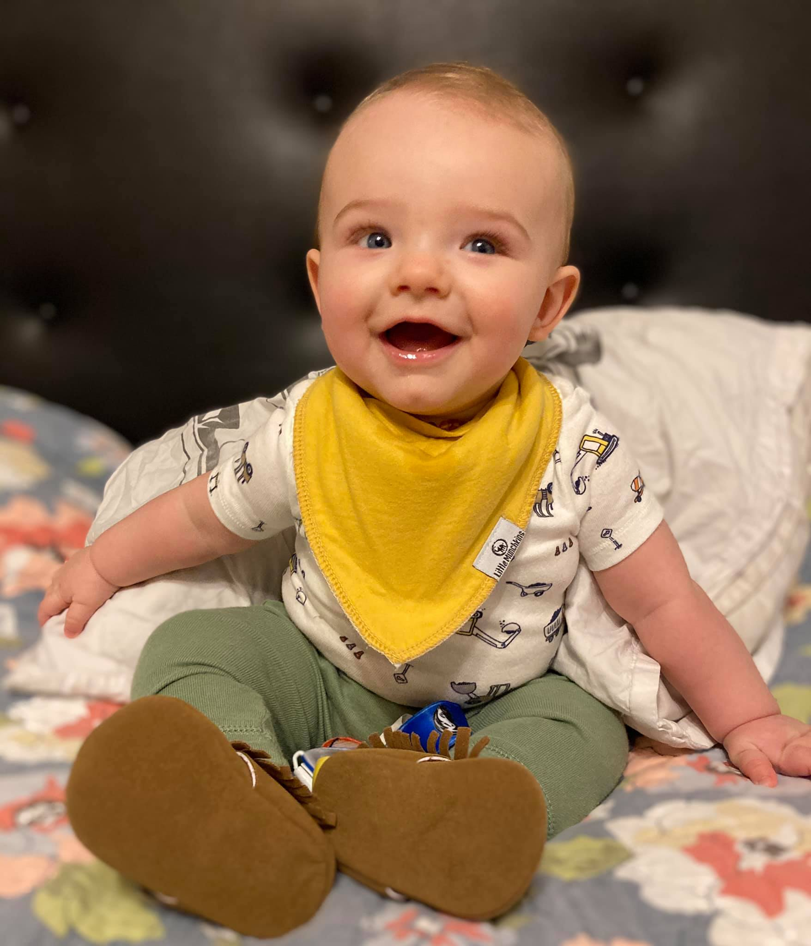
Noah...
... That smile!

Slide 5
Prayer and Announcements
Sunday:
9:15 Small Group Sunday School Classes
(Kids class and nursery as well)
10:30 Worship

Slide 7
BEGIN HERE OCTOBER 28, 2020
LAST WEEK 22 Revelation 14 b
Time for Reaping
THIS WEEK 23 Revelation 15
The End of Wrath

Slide 9
Revelation 15 The End of Wrath

Slide 10
Revelation 15:1 The Last Plagues
1 Then I saw another sign in heaven, great and marvelous, seven angels who had seven plagues, which are the last, because in them the wrath of God is finished.
Notes:
the last, because in them the wrath of God is finished
No fear of God in eternity for believers... Because no more wrath!

Slide 11
Revelation 15:2-3 The Song of the Victorious
2 And I saw something like a sea of glass mixed with fire, and those who had been victorious over the beast and his image and the number of his name, standing on the sea of glass, holding harps of God. 3 And they sang the song of Moses, the bond-servant of God, and the song of the Lamb, saying,
Notes:
2 And I saw something like a sea of glass mixed with fire
and those who had been victorious over the beast and his image and the number of his name, standing on the sea of glass,
HOW VICTORIOUS??? Revelation 12:10-12 10 Then I heard a loud voice in heaven, saying,
“Now the salvation, and the power, and the kingdom of our God and the authority of His Christ have come, for the accuser of our brethren has been thrown down, he who accuses them before our God day and night. 11 And they overcame him because of the blood of the Lamb and because of the word of their testimony, and they did not love their life even when faced with death. 12 For this reason, rejoice, O heavens and you who dwell in them. Woe to the earth and the sea, because the devil has come down to you, having great wrath, knowing that he has only a short time.”
holding harps of God. 3 And they sang the song of Moses, the bond-servant of God, and the song of the Lamb, saying,

Slide 12
Revelation 15:3-4 The Song of Moses and the Lamb
“Great and marvelous are Your works,
O Lord God, the Almighty;
Righteous and true are Your ways,
King of the nations!
4 “Who will not fear, O Lord, and glorify Your name?
For You alone are holy;
For all the nations will come and worship before You,
For Your righteous acts have been revealed.”
Notes:
V 3 cont.... The song of Moses and the song of the Lamb:
As God’s judgment and wrath come, His works and ways are judged as great and marvelous and righteous and true.
The world followed after the beast and false prophet, but should have feared the Lord and glorified His name.
For all the nations will come and worship before You
BECAUSE His righteous acts are revealed...
As opposed to the beast!!!
When you know and see the Truth, you see God’s righteousness!!!
Right now we have to accept it by FAITH.

Slide 13
Revelation 15:3-4 The Song of Moses and the Lamb
“Great and marvelous are Your works,
O Lord God, the Almighty;
Righteous and true are Your ways,
King of the nations!
4 “Who will not fear, O Lord, and glorify Your name?
For You alone are holy;
For all the nations will come and worship before You,
For Your righteous acts have been revealed.”
Notes:
V 3 cont.... The song of Moses and the song of the Lamb:
Exodus 15 I will sing unto the Lord, for he hath triumphed gloriously: The horse and the rider throne into the sea
OR
Deuteronomy 32
3 “For I proclaim the name of the Lord; Ascribe greatness to our God! 4 “The Rock! His work is perfect, For all His ways are just; A God of faithfulness and without injustice, Righteous and upright is He.
5 “They have acted corruptly toward Him, They are not His children, because of their defect; But are a perverse and crooked generation. 6 “Do you thus repay the Lord, O foolish and unwise people? Is not He your Father who has bought you? He has made you and established you.......
35 ‘Vengeance is Mine, and retribution, In due time their foot will slip; For the day of their calamity is near, And the impending things are hastening upon them.’ 36 “For the Lord will vindicate His people, And will have compassion on His servants, When He sees that their strength is gone, And there is none remaining, bond or free.
39 ‘See now that I, I am He, And there is no god besides Me; It is I who put to death and give life. I have wounded and it is I who heal, And there is no one who can deliver from My hand. 40 ‘Indeed, I lift up My hand to heaven, And say, as I live forever, 41 If I sharpen My flashing sword, And My hand takes hold on justice, I will render vengeance on My adversaries, And I will repay those who hate Me. 42 ‘I will make My arrows drunk with blood, And My sword will devour flesh, With the blood of the slain and the captives, From the long-haired leaders of the enemy.’
43 “Rejoice, O nations, with His people; For He will avenge the blood of His servants,
And will render vengeance on His adversaries, And will atone for His land and His people.”

Slide 14
Revelation 15:3-4 The Song of Moses and the Lamb
“Great and marvelous are Your works,
O Lord God, the Almighty;
Righteous and true are Your ways,
King of the nations!
4 “Who will not fear, O Lord, and glorify Your name?
For You alone are holy;
For all the nations will come and worship before You,
For Your righteous acts have been revealed.”
Notes:
Righteous and true are your ways
Ezekiel 18 ➔ SEE NEXT SLIDE ➔
29 But the house of Israel says, ‘The way of the Lord is not right.’ Are My ways not right, O house of Israel? Is it not your ways that are not right?
30 “Therefore I will judge you, O house of Israel, each according to his conduct,” declares the Lord God. “Repent and turn away from all your transgressions, so that iniquity may not become a stumbling block to you. 31 Cast away from you all your transgressions which you have committed and make yourselves a new heart and a new spirit! For why will you die, O house of Israel? 32 For I have no pleasure in the death of anyone who dies,” declares the Lord God. “Therefore, repent and live.”
We need forgiveness from God not fairness...
Fairness would call for us to be judged according to our conduct!

Slide 15
Ezekiel 18:29-32 The Lord is Right
29 But the house of Israel says, ‘The way of the Lord is not right.’ Are My ways not right, O house of Israel? Is it not your ways that are not right?
30 “Therefore I will judge you, O house of Israel, each according to his conduct,” declares the Lord God. “Repent and turn away from all your transgressions, so that iniquity may not become a stumbling block to you. 31 Cast away from you all your transgressions which you have committed and make yourselves a new heart and a new spirit! For why will you die, O house of Israel? 32 For I have no pleasure in the death of anyone who dies,” declares the Lord God. “Therefore, repent and live.”
Notes:
each according to his conduct
Jeremiah 17:10: “I, the Lord, search the heart, I test the mind, even to give to each man according to his ways, according to the results of his deeds.”
Jeremiah 32:19, the prophet in prayer describes God as “giving to everyone according to his ways and according to the fruit of his deeds.”
Ezekiel 33:20, the Lord says, “O house of Israel, I will judge each of you according to his ways.”
Matthew 16:27, Jesus says, “For the Son of Man is going to come in the glory of His Father with His angels, and will then repay every man according to his deeds.”
2 Cor. 5:10, “For we must all appear before the judgment seat of Christ, so that each one may be recompensed for his deeds in the body, according to what he has done, whether good or bad.”
Galatians 6:7-8, “Do not be deceived, God is not mocked; for whatever a man sows, this he will also reap. For the one who sows to his own flesh will from the flesh reap corruption, but the one who sows to the Spirit will from the Spirit reap eternal life.”
Ephesians 5:6, after describing the evil deeds of the wicked, Paul warns, “Let no one deceive you with empty words, for because of these things the wrath of God comes upon the sons of disobedience.”
Revelation 2:23, after telling how He will judge those who join in the immorality and idolatry of “the woman Jezebel,” the Lord warns the church in Thyatira, “I will give to each one of you according to your deeds.”
Revelation 20:12, at the great white throne judgment, “the dead were judged from the things which were written in the books, according to their deeds.”
Revelation 22:12, Jesus says, “Behold, I am coming quickly, and My reward is with Me, to render to every man according to what he has done.”
(See, also, Job 34:10-12; Ps. 28:4; Jer. 25:14; 51:24; Hos. 12:2; Matt. 25:31-46; John 5:28-29; 1 Cor. 3:8; 2 Cor. 11:15; Eph. 6:8; Col. 1:21-23; 3:5-6, 24; 2 Tim. 4:14.)
The Way of Salvation...
Repent and turn away from all your transgressions
so that iniquity may not become a stumbling block to you.
31 Cast away from you all your transgressions which you have committed and
make yourselves a new heart and a new spirit!
For why will you die, O house of Israel?
32 For I have no pleasure in the death of anyone who dies,” declares the Lord God.
“Therefore, repent and live.”

Slide 16
Revelation 15:5-8 Bowls Full of Wrath
5 After these things I looked, and the temple of the tabernacle of testimony in heaven was opened, 6 and the seven angels who had the seven plagues came out of the temple, clothed in linen, clean and bright, and girded around their chests with golden sashes. 7 Then one of the four living creatures gave to the seven angels seven golden bowls full of the wrath of God, who lives forever and ever. 8 And the temple was filled with smoke from the glory of God and from His power; and no one was able to enter the temple until the seven plagues of the seven angels were finished.
Notes:
5 ...the temple of the tabernacle of testimony in heaven was opened,
6 and the seven angels who had the seven plagues came out of the temple,
clothed in linen, clean and bright, and girded around their chests with golden sashes.
ROYAL AND RIGHTEOUS!
Newport: The fact that the seven angels came out of the temple suggest that the judgments they are to deliver are expressions of God’s righteous and holy will. (257)
7 Then one of the four living creatures gave to the seven angels seven golden bowls full of the wrath of God,
who lives forever and ever.
Newport: Bowls ➔ could be shallow drinking bowls (amos 6:6) or ritual bowls used for collecting the blood of sacrifices (Exodus 27:3)
8 And the temple was filled with smoke from the glory of God and from His power; and no one was able to enter the temple until the seven plagues of the seven angels were finished. (smoke ➔ Exodus 24:16; 40:34-38; 1 Kings 8:10-11)
ONLY God is involved in His wrath... No one else can be blamed... No one else can be righteous in judgment!!!

Slide 17
Revelation 16 The Final Bowls of Wrath

Slide 18
Revelation 16:1-2 The First Bowl of Wrath
1 Then I heard a loud voice from the temple, saying to the seven angels, “Go and pour out on the earth the seven bowls of the wrath of God.”
2 So the first angel went and poured out his bowl on the earth; and it became a loathsome and malignant sore on the people who had the mark of the beast and who worshiped his image.
Notes:
Loud voice from the Temple = ALL still directed by God!!!
first angel : a loathsome and malignant sore on the people who had the mark of the beast and who worshiped his image.
Not for believers who are marked by the seal of the Holy Spirit
AGAIN... Had the mark of the beast AND worshiped his image!!!
Don’t worry if you don’t worship anyone other than the LORD
Think about the panic of pandemic of 2020 – can you imagine if everyone breaks out in loathsome sores?!?

Slide 19
Revelation 16:3 The Second Bowl of Wrath
3 The second angel poured out his bowl into the sea, and it became blood like that of a dead man; and every living thing in the sea died.
Notes:
second : the sea... became blood like that of a dead man
not even fresh blood, but that of a dead man!
Every living thing in the sea died
EVERY!
(as opposed to Rev 8:8-9 where a third of sea life died with the second trumpet)

Slide 20
Revelation 16:4-7 The Third Bowl of Wrath
4 Then the third angel poured out his bowl into the rivers and the springs of waters; and they became blood. 5 And I heard the angel of the waters saying, “Righteous are You, who are and who were, O Holy One, because You judged these things; 6 for they poured out the blood of saints and prophets, and You have given them blood to drink. They deserve it.” 7 And I heard the altar saying, “Yes, O Lord God, the Almighty, true and righteous are Your judgments.”
Notes:
third : the rivers and the springs of waters... became blood.
Rev 8:10-11 Star name “wormwood” fell and polluted a third of the fresh waters and many men died from the bitter waters
5 ... the angel of the waters, ➔ God has angels that protect all sorts of things!!!
“Righteous are You, who are and who were, O Holy One, because You judged these things;
6 for they poured out the blood of saints and prophets,
and You have given them blood to drink. They deserve it.”
In Leviticus, God said drinking or eating blood was strictly forbidden, but now is used as wrath.
7 And I heard the altar saying, “Yes, O Lord God, the Almighty, true and righteous are Your judgments.” ➔ EZEKIEL 18:29-32

Slide 21
Revelation 16:8-9 The Fourth Bowl of Wrath
8 The fourth angel poured out his bowl upon the sun, and it was given to it to scorch men with fire. 9 Men were scorched with fierce heat; and they blasphemed the name of God who has the power over these plagues, and they did not repent so as to give Him glory.
Notes:
8 fourth : the sun... scorch men with fire.
Rev 8:12 fourth trumpet: a third of the sun, moon and stars were struck so night and day would be darker.
they blasphemed the name of God who has the power over these plagues,
They recognized where the plagues came from but would not repent!!
Thought God was mean rather than righteous... He caused their suffering rather than their sins!
and they did not repent so as to give Him glory.
Seems to indicate that there would still be time to repent!!!

Slide 22
Revelation 16:10-11 The Fifth Bowl of Wrath
10 Then the fifth angel poured out his bowl on the throne of the beast, and his kingdom became darkened; and they gnawed their tongues because of pain, 11 and they blasphemed the God of heaven because of their pains and their sores; and they did not repent of their deeds.
Notes:
10 fifth : the throne of the beast, and his kingdom became darkened;
gnawed their tongues because of pain,
blasphemed the God of heaven because of their pains and their sores
did not repent of their deeds
POST-APOCALYPTIC FILMS!!! The end is coming and worse than imagined!!

Slide 23
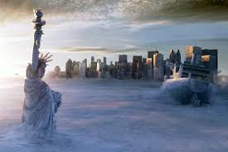
Post-Apocalyptic Vision
Notes:
2012 maybe?

Slide 24
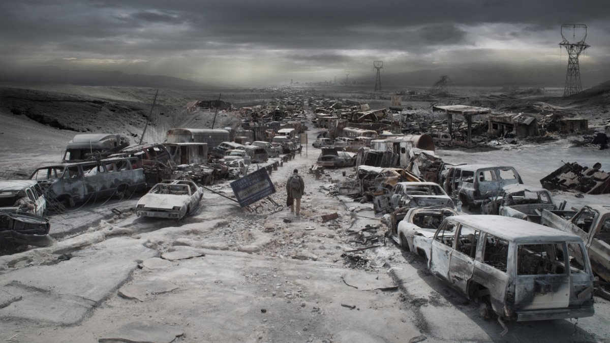
Post-Apocalyptic Vision
Notes:
The Book of Eli

Slide 25
END HERE October 28, 2020

